Slide 1

Developing XML Web Services and Server Components with Visual C# .NET
PART I
WINDOWS SERVICES
Amir Ahani
Microsoft Certified Solution Developer (MCSD .NET)
Microsoft Certified Application Developer (MCAD)
Microsoft Embedded Partner (www.mswep.com)

Slide 2

INTRODUCING WINDOWS SERVICES

Slide 3
Understanding Windows Services
The Windows operating system provides the following services:
  Kernel Services – The kernel is the core part of the operating
  system responsible for process, thread, and memory management.
  Kernel services enable devices and applications to interact with the
  kernel and use its functionality. (System Programmers)
  Device Driver Services – A device driver controls and manages the
  hardware devices. Device driver services enable applications to work
  with devices. (System Programmers)
  Windows Services – Windows services enable operating system
  components and application programs to expose their functionality to
  other applications.

Slide 4
Understanding Windows Services
In general, a Windows service is a process that provides background
services to other processes. Some typical examples of Windows
services are World Wide Web Publishing, Print Spooler, Task Scheduler,
Event Log, Plug and Play, and so on. Some common characteristics of
Windows services are:
  Conformance to SCM—Each Windows service must implement a set of
  well-known methods, which enable the service to communicate with the
  SCM. These well-known methods define how a Windows service should
  handle the SCM messages. Some common messages sent by SCM to a
  service are Start, Pause, Continue, and Stop. How these messages are
  handled depends totally on the service, because not all Windows services
  accept all messages. For example, the Event Log, the Plug and Play, and the
  Security Accounts Manager Windows services do not accept Pause and Stop
  messages and therefore cannot be paused or stopped. In contrast, the Print
  Spooler and the System Event Notification Windows services can be started
  or stopped but cannot be paused.

Slide 5
Understanding Windows Services
  Lack of User Interface—Although Windows services can interact with the
  desktop and provide a user interface, most services don’t. Windows services
  perform system tasks that usually do not require any user interface. As an
  example, the job of IIS (Internet Information Services) is to serve the
  requested Web pages, and IIS does not require any user interface or desktop
  interaction to accomplish this job. IIS is launched when a computer is started
  and its process remains unseen by a Windows desktop user.
  Specific User Identity—Most Windows services run with System privileges.
  System is a special account that Windows uses to perform privileged
  operations. However, each Windows service can be launched with a specific
  user identity. This feature can restrict services to the permissions defined for
  an individual user. The administrator can easily accomplish this by following these two steps:
    1. Set up a user account with the set of permissions that the administrator wants the service to have.
    2. Configure the Windows service to run with the user identity that was created in step 1.

Slide 6
Understanding Windows Services
  Separate Windows Process—A Windows service does not run in the
  process of the program that communicates with it. Instead, a Windows
  service runs in its own process. Sometimes, a Windows service can also
  share a process with another Windows service.
  Special Installation Procedure—Unlike a Windows application, a Windows
  service cannot be started by just executing its .exe file. Instead, a Windows
  service requires a special installation procedure. This installation procedure
  registers the Windows service with the Windows Service Control Manager
  (SCM). The SCM provides varied functionality to control (such as to start,
  pause, and stop a service) and configure (such as setting up a service user
  account) the Windows services.
  Long-lived Process—Typically, a Windows service is started automatically
  when the computer is started and continues to live. Services can execute
  even when no user is logged on to the system. Most Windows services
  provide the functionality that enables them to be paused, resumed, started,
  or stopped.

Slide 7
Practical Point
→ Communication via Event Log
Windows services run in the background and generally do not provide a
user interface. However, a Windows service may need to inform the user
about an application state or an event in the environment. Most Windows
services do so by writing informative messages in the event log.

Slide 8
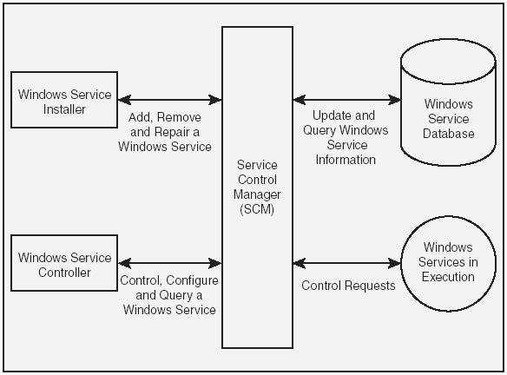
Architecture of Windows Services

Slide 9
Architecture of Windows Services
Windows Service Database
  The Windows service database stores information about all the installed
  services. This database is a part of the Windows Registry and is stored in the
  HKEY_LOCAL_MACHINE\SYSTEM\CurrentControlSet\Services key. The
  Windows service database typically contains the following information for
  each Windows service:
    Path to the executable file.
    Security settings.
    Startup parameters.
  Even though you can directly manipulate the Windows service database by
  modifying the Windows Registry using the regedit command or through a
  program, it is not recommended that you do so. To ensure the integrity of the
  database, you should always manipulate the Windows service database
  through the interfaces that the SCM provides.
  Example: MSSQLServer Auto-start service (Auto-Start → 2, Manual → 3)

Slide 10
Architecture of Windows Services
Service Control Manager (SCM)
  SCM is a Windows component that maintains the Windows service
  database and provides a unified way to control, configure, and
  access these services. The SCM performs the following tasks:
    Accepts requests to install and uninstall Windows services from
    the Windows service database.
    Starts Windows services either on system startup or on demand.
    Transmits control messages (such as Start, Stop, Pause, and Continue)
    to running Windows services.
    Locks and unlocks the Windows service database.
  Windows provides a generic interface to work with the SCM through the
  Services and Computer Management MMC (Microsoft Management
  Console) snap-ins. These MMC snap-ins can be accessed through the
  Administrative tool section of the Windows Control Panel. Some applications,
  such as IIS and SQL Server, provide their own MMC snap- ins to control and
  configure their services.

Slide 11
Architecture of Windows Services
Windows Service Installer
  A Windows service installer uses the SCM to install, uninstall, and repair a
  Windows service. The install, uninstall, and repair actions respectively
  create, delete, and update a Windows service record in the Windows service
  database.
  While installing a service, the Windows service installer also stores
  information about how the service will be started. This information includes:
    A name that uniquely identifies the service in the Windows service
    database.
    The account name and password under whose identity the service runs.
    How the Windows service process is created (an independent process or
    a shared process).
    How the service is started (automatically when Windows starts, manual
    start, disabled).

Slide 12
Architecture of Windows Services
Windows Services in Execution
  A Windows service must be explicitly started (by default). However, it is also
  possible to set up a service in such a way that the service is started
  automatically with Windows.
  When the SCM starts a service, it attempts to create a Windows process for
  that service based on the information stored in the Windows service
  database. The SCM also sends a Start message to the service; this message
  invokes an associated handler in the service (if any) that specifies the
  processing to be done. After a Windows service is started, it continues to run
  until it receives a pause message or a stop message.
  When a Windows service is paused, the process for the Windows service
  continues to exist, but the service does not listen to the requests from the
  client programs. On the other hand, when a Windows service is stopped, its
  process is terminated and the memory is reclaimed.

Slide 13
Architecture of Windows Services
Windows Service Controller Program
  The Windows service controller program uses the SCM to perform the
  following tasks:
    Start a Windows service.
    Stop a Windows service.
    Pause a Windows service.
    Resume the execution of a paused Windows service.
    Query the Windows service database to retrieve the status for a Windows service.
    Install a new Windows service in the Windows service database.
    Uninstall an installed Windows service from the Windows service
    database.
    Modify the configuration information for a Windows service.
  Although the Services MMC snap-in provides generic control and
  configuration options for Windows services, it cannot take care of the
  individual configuration requirements and customized user interface for each
  Windows service.

Slide 14
The FCL Support for Windows Services
The System.ServiceProcess namespace provides the classes that
enable you to implement, install, and control Windows services. The
main classes involved in working with Windows service applications are:
  The ServiceBase Class A class that provides the base-level functionality
  for a Windows services application.
  The ServiceProcessInstaller and ServiceInstaller Classes
  Classes that enable you to use an installation utility such as installutil.exe to
  install a Windows services application.
  The ServiceController Class A class that enables a program to connect to
  a Windows service and perform various operations such as starting,
  stopping, querying etc.

Slide 15
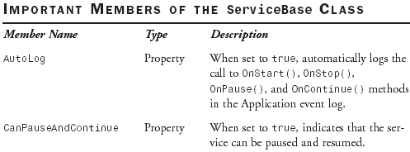
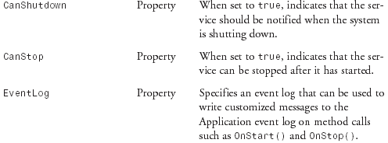
Creating a Windows Service Application
The System.ServiceProcess.ServiceBase Class

Slide 16
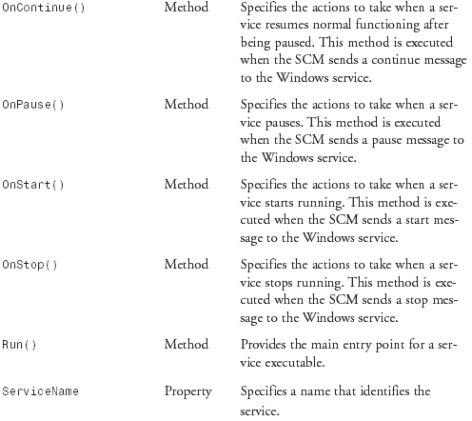
Creating a Windows Service Application
The System.ServiceProcess.ServiceBase Class

Slide 17
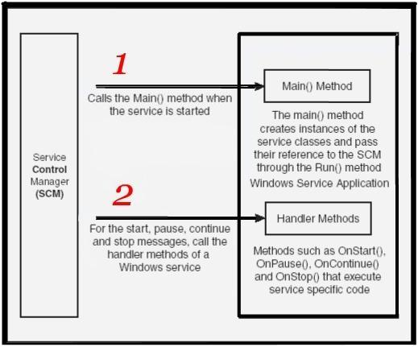
How the SCM Interacts with a Windows Service
A Windows service application contains one or more classes that inherit
from the ServiceBase class to define a Windows service.
Only one of these classes can define a Main() method, which is the main
entry point for the application. The Main() method specifies which
Windows services should run by passing the instances of the Windows
service to the static ServiceBase.Run() method.
The Run() method does not actually start the Windows service; instead,
the Run() method just passes references to the Windows service objects
to the SCM. The SCM uses these objects to send messages to the
Windows service.

Slide 18
How the SCM Interacts with a Windows Service
When the SCM sends a start message to the Windows service, the
following things happen:
  1. The SCM finds the path of the Windows service application’s executable
  file from the Windows service database.
  2. The SCM creates a Windows service process by executing the Main()
  method defined in the Windows service executable.
  3. The Main() method of the Windows service executable creates one or
  more instances of the Windows service class and passes their references
  to the SCM through the static Run() method of the ServiceBase class. The
  SCM uses these references to send messages to the Windows service.
  4. The handler associated with the start message—the OnStart() method—is
  executed. The OnStart() method executes the code that is required for a
  Windows service to run, such as listening to a port for incoming requests,
  logging events to the event log, spooling print jobs, and so on.
  After the Windows service is started, the SCM can use its reference to send
  various messages such as pause, continue, and stop to the Windows
  service.

Slide 19

Creating the OrderService Application
// Executes when an XML file is created in or copied to the c:\orders directory
private void fswOrders_Created(object sender, System.IO.FileSystemEventArgs e){
DataSet dsOrders = new DataSet(“Orders”);
// Read the contents of the XML file into the Orders DataSet
dsOrders.ReadXml(e.FullPath);
// set up the database connection string
string strConn = “data source=(local);” + “initial catalog=Northwind;” + “integrated security=SSPI”;
string strOrderQuery = “SELECT * FROM Orders”;
// Create a DataAdapter for the Orders table of the Northwind database
SqlDataAdapter daOrders =new SqlDataAdapter(strOrderQuery, strConn);
// Automatically generate the update command to reconcile the changes made to the DataSet
SqlCommandBuilder cbOrders =new SqlCommandBuilder(daOrders);
//Update the DataSet
daOrders.Update(dsOrders, “Orders”);
daOrders.Dispose();
FileInfo fi = new FileInfo(e.FullPath);
// Create a subdirectory named “Updated” if it does not already exist
fi.Directory.CreateSubdirectory(“Updated”);
// Copy the processed XML file to updated directory, overwriting if needed
File.Copy(e.FullPath, fi.DirectoryName + @”\Updated\” + fi.Name, true);
// Delete the XML file from its original location
fi.Delete();
}
To demonstrate how Windows services are created, We will create an OrderService that listens for XML files containing order information in a particular disk directory (c:\orders). As soon as XML file is created in directory, the service reads the files and based on its data, creates a new record in the orders table of the Northwind database. This type of application is typically used for updating orders received from the internet, from business partners, and from the legacy aaplications.
SBS 6.1 Example

Slide 20
Practical Point
→ The FileSystemWatcher Component may lose track of changes
The FileSystemWatcher component stores the file system changes in a
property named InternalBufferSize before it acts upon those changes.
If there are too many changes in a short time, this buffer can overflow
and cause the FileSystemWatcher component to lose track of the file
system changes. This buffer’s default size is 8192 bytes. You should
not arbitrarily increase this buffer’s size because this buffer is
maintained in non-paged memory and increasing its size would directly
impact the performance of other applications. Instead, you should use
the Path, NotifyFilter, and IncludeSubdirectories properties to narrow
down the scope of notifications that the FileSystemWatcher component
receives.

Slide 21
Installing a Windows Service
When you use an installation tool such as installutil.exe to install
a Windows service application, the installation tool takes the following
steps:
1. It looks for an installer class in the Windows service application
that has its RunInstaller attribute set to true and creates an instance of
this class.
2. It gets a collection of custom installer objects from the Installers
property and invokes the Install() method on each of these objects to
perform the custom installation.
3. It rolls back the installation of all custom installers if any one of them
failed.
The .NET Framework enables you to create custom installer components. The
custom installer components are the classes that an installation tool, such as
installutil.exe, can use to properly install an application;
  The System.ServiceProcess.ServiceProcessInstaller Class—This class
  creates the records for all the Windows services contained with the
  application in the Windows service database. You need to have just one
  instance of the ServiceProcessInstaller class in a Windows service
  application. (Security)
  The System.ServiceProcess.ServiceInstaller Class—This class writes
  specific information about a Windows service to the Windows service
  database. You’ll have as many instances of the ServiceInstaller class as the
  number of services in a Windows service application. (Database)
  The System.Configuration.Install.Installer Class—This class works as the
  entry point for the installation process. The Installer class maintains a
  collection of custom installer objects, which can be accessed through the
  Installers property. You should add the instance of the
  ServiceProcessInstaller class and instances of the ServiceInstaller class of
  the Windows service application to this collection. You should also apply the
  RunInstaller attribute to this class and set its value to true.

Slide 22
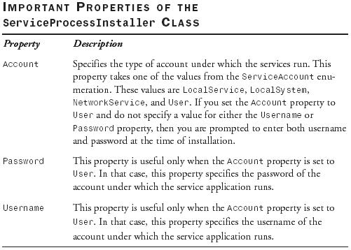
The ServiceProcessInstaller Class
The ServiceProcessInstaller class specifies the security settings for the
Windows services in the Windows service application.

Slide 23
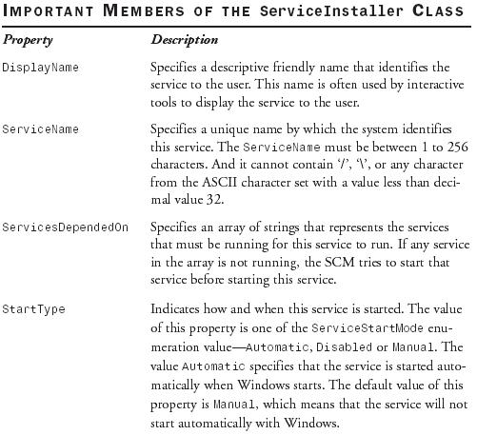
The ServiceInstaller Class
The ServiceInstaller specifies the individual settings for each service in
the Windows service database.

Slide 24
Practical Point
→ The ServiceProcessInstaller Class
Some Accounts Are XP-only
The LocalService and NetworkService accounts are only available on
Windows XP and Windows Server 2003. These accounts do not exist
on Windows 2000 or older operating systems.
(NetworkService: ASP .NET State Service (Out-Process apps), DNS and RPC Locator)
→ The ServiceInstaller Class
The ServiceName Property The ServiceName property of a ServiceInstaller object must exactly match the ServiceName property of the corresponding Windows service class.

Slide 25
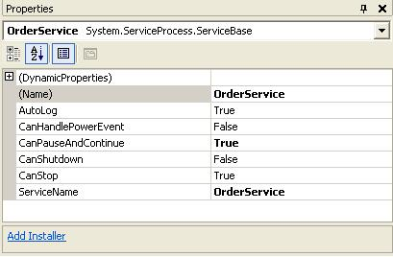
Adding Installer Classes to a Windows Service
The Properties window of the Windows service, as shown, displays a link called Add Installer. When you click on that link, Visual Studio .NET automatically adds a class named ProjectInstaller in your project. This class derives from the Installer class and contains an instance of the ServiceProcessInstaller class and one or more instances of the ProcessInstaller class (depending on the number of Windows services you have in the application).
Creating an Installer for the Windows Service
1. Open the project SBS6_1. Access the design view for the OrderService component. Click anywhere on the background of the designer to select the service itself, rather than any of its components. Access the Properties window for the service. In the gray area below the list of properties, you see a hyperlink named Add Installer. Click on the hyperlink.
2. The preceding step adds a component named ProjectInstaller.cs to the SBS6_1 project. Access the design view for ProjectInstaller.cs to see that it has two components: serviceProcessInstaller1 and serviceInstaller1.
3. Access the properties for the serviceProcessInstaller1 component. You’ll note that this component is an instance of the ServiceProcessInstaller class. Change its Account property from User to LocalSystem.
4. Access the properties for the serviceInstaller1 component. You’ll note that this component is an instance of the ServiceInstaller class. Change its DisplayName and ServiceName properties to OrderService and the StartType property to Automatic.
5. Build the project SBS6_1. The Windows service is now
ready to be installed. (Using installutil.exe)
SBS 6.2 Example

Slide 26
Using Installer tool to Install a Windows Service
Microsoft (R) .NET Framework Installation utility Version 1.1.4322.573
Copyright (C) Microsoft Corporation 1998-2002. All rights reserved.
Running a transacted installation
Beginning the Install phase of the installation
See the contents of the log file for the f:\sbs6_1\bin\debug\sbs6_1.exe assembly's progress.
The file is located at f:\sbs6_1\bin\debug\sbs6_1.InstallLog.
Installing assembly 'f: \sbs6_1\bin\debug\sbs6_1.exe'.
Affected parameters are:
assemblypath = f:\sbs6_1\bin\debug\sbs6_1.exe
logfile = f:\sbs6_1\bin\debug\sbs6_1.InstallLog
Installing service OrderService...
Service OrderService has been successfully installed.
Creating EventLog source OrderService in log Application...
The Install phase completed successfully, and the Commit phase is beginning.
See the contents of the log file for the f:\sbs6_1\bin\debug\sbs6_1.exe assembly's progress.
The file is located at f:\sbs6_1\bin\debug\sbs6_1.InstallLog.
Committing assembly 'f:\sbs6_1\bin\debug\sbs6_1.exe'.
Affected parameters are:
assemblypath = f:\sbs6_1\bin\debug\sbs6_1.exe
logfile = f:\sbs6_1\bin\debug\sbs6_1.InstallLog
The Commit phase completed successfully.
The transacted install has completed.
You can easily install an executable file that has the code for the installer class by using the command line Installer tool (installutil.exe) that comes as a part of the .NET Framework SDK.
SBS 6.3 demonstrates how to use installutil.exe to install a Windows service application in the Windows service database.
Using installutil.exe to Install a Windows Service Application
1. Open the Visual Studio .NET command prompt by selecting Start, Programs, Microsoft Visual Studio .NET, Visual Studio .NET Tools, Visual Studio .NET Command Prompt. Change the directory to the bin\debug directory of the SBS6_1 project where the .exe file for the Windows service application is stored.
2. Issue the following command:
installutil SBS6_1.exe
SBS 6.3 Example

Slide 27
Starting a Windows Service
4. Create an XML file named Orders.xml and store the following information in this file:
<?xml version=”1.0” standalone=”yes”?>
<dsOrders xmlns=”http://www.tempuri.org/dsOrders.xsd”>
<Orders>
<CustomerID>VINET</CustomerID>
<EmployeeID>5</EmployeeID>
<OrderDate>2002-10-11</OrderDate>
<RequiredDate>2002-10-21</RequiredDate>
<ShippedDate>2002-10-18</ShippedDate>
<ShipVia>3</ShipVia>
<Freight>22.38</Freight>
<ShipName>Vins et alcools Chevalier</ShipName>
<ShipAddress>59 rue de l’Abbaye</ShipAddress>
<ShipCity>Reims</ShipCity>
<ShipRegion>MI</ShipRegion>
<ShipPostalCode>51100</ShipPostalCode>
<ShipCountry>France</ShipCountry>
</Orders>
</dsOrders>
5. Copy this file to the c:\orders directory. You’ll note that in a few moments the Orders.xml file is moved from c:\orders to a new subdirectory, c:\orders\updated.
6. Query the Orders table in the Northwind database. You’ll find that a record has been added to the Orders table with the information in the Orders.xml file.
7. Create another orders file in the c:\orders directory. You’ll note that the file is moved again to the updated subdirectory and the Orders table is updated.
1. Create a directory c:\orders. This is the directory where the incoming orders will be created as an XML file.
2. Restart the computer; the OrderService is started automatically when Windows is started.
3. Right-click on the My Computer icon and select Manage from its shortcut menu. In the Computer Management window, navigate to System Tools, Event Viewer, Application. You’ll see that OrderService has written an informational message to the Application event log. Double-click to open the message; you’ll see that the message is about the successful start of OrderService.
In this exercise, The FileSystemWatcher is configured not to listen to any of the Subdirectories inside c:\orders; therefore XML files created in c:\orders\updated do not raise any events of interest to the FileSystemWatcher component.
SBS 6.4 Example

Slide 28
Guided Practice Exercise 6.1
GP 6.1 Example
4. Switch to the code view and change all occurrences of Service1 to DbConnectSingletonServer. Add the following using directives to the code:
using StepByStep3_9; using StepByStep3_10;
using System.Runtime.Remoting;
using System.Runtime.Remoting.Channels;
using System.Runtime.Remoting.Channels.Tcp;
5. In the code, search for the skeleton of the OnStart() method and modify it as follows:
protected override void OnStart(string[] args){
// Register a TCP server channel that listens on port 1234
TcpServerChannel channel =new TcpServerChannel(1234);
ChannelServices.RegisterChannel(channel);
// Resgister the service that publishes DbConnect for remote access in Singleton mode
RemotingConfiguration.RegisterWellKnownServiceType(typeof(SBS3_10.DbConnect), “DbConnect”, WellKnownObjectMode.Singleton);}
6. Access the Properties window for the DbConnectSingletonServer component. Click on the Add Installer hyperlink. This adds a component named ProjectInstaller.cs to the project.(Change its Account property from User to LocalSystem, Change its ServiceName and DisplayName properties to DbConnectSingletonServer and the StartType property to Automatic.)
7. Build the project, installutil GP6_1.exe and NET Start DbConnectSingletonServer.
8. Run the executable file SBS3_12.exe for the project created. In the window that
appears type queries for retrieving data from the Northwind database.
(Such as: Select * from Customers, stop the service and then rerun the query)
When you want to remote an object by some method other than using IIS, you have to create a remoting server (“.NET Remoting”) and manually start the service whenever the computer is restarted. When you implement a remoting server as a
Windows service, it is easy to ensure that the remoting server is automatically started with Windows.
The objective of this exercise is to create a Windows service that exposes the DbConnect class of the SBS3_10 project as a Singleton server-activated object. You’ll use a client program such as the one created in SBS3_12 project to connect to this service. The server and client should communicate via the TCP channels and the binary formatter. The service should start automatically when Windows is started. The service should allow itself to be stopped but should not support pause and continue operations.
1. Add a new Visual C# .NET Windows Service application named GP3_1 to the solution.
2. Add references to the .NET assembly System.Runtime.Remoting, and to the project SBS3_9 and SBS3_10 that you created in Chapter 3 (the interface to the remotable class and the remotable class itself ).
3. In the Solution Explorer, rename the default Service1.cs to DbConnectSingletonServer.cs. Click on the designer surface, and then in the Properties window. Set the Name and ServiceName properties to DbConnectSingletonServer.

Slide 29
Using Tools to Monitor a Windows Service
Using the Services MMC Snap-in
Using Visual Studio .NET Server Explorer
Using the NET Utility (net.exe)
  Net Start (Pause, Continue and Stop)
Using the Service Control Utility (sc.exe)
  The Service Control utility provides various options to start, pause, continue,
  stop, configure, and query a Windows service

Slide 30
Practical Point
→ Windows Service Description
Unfortunately, the Installer class does not have a property to set the description
for a Windows Service. If you need to set a description for a service, you have
two choices: Either use the Service Control utility (sc.exe) or modify the
Registry key corresponding to the Windows service
(HKEY_LOCAL_MACHINE/System/CurrentControlSet/Services/ServiceName),
add a string value named Description, and set the data for this value with the
description text.
  To change the description of OrderService, you can use the following form of
  the sc.exe command:
  sc.exe description OrderService “This service listens to creation of order files
  (*.XML) in c:\orders directory. When a XML file is created in this directory, the
  XML data in the file is added as a new record to the Orders table of the
  NorthWind database” You can query the description by using the following
  command:
  sc.exe qdescription OrderService

Slide 31
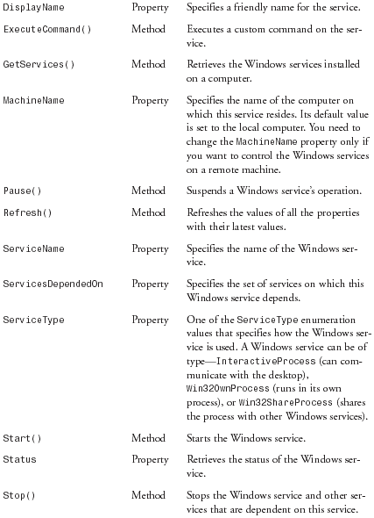
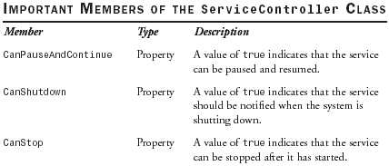
Controlling a Windows Service
You can use the ServiceController class of the System.ServiceProcess
namespace to programmatically control Windows services from your programs.
You may use this in the scenario where you want to take some action based on
the status of a service or you may want to take some actions in a program that
require you to start, pause, continue, or stop a Windows service.

Slide 32

Creating a Windows Service Controller
In SBS 6.5, most of the code is written to make the user interface work logically. For Windows service control, I am using the ServiceController.GetServices() static method to get a list of installed services that I populate in the lbServiceList control.
When the user clicks on the btnStart button, I am calling the Start() method to start the selected Windows service. The Windows service might take some time to start, and meanwhile I should restrict the user from pressing any other buttons; therefore I am calling the synchronous WaitForStatus() method that waits till the Windows service returns a Running status. I followed a similar logic for other control messages.
SBS 6.5 Example

